Slide 1
Diffusion
Diffusion is the process by which gas moves from regions of high density to regions of low, driven by the relative pressure of the different regions.
Diffusion in a network (Influence network):
  The spread of an idea
  The spread of a disease

Slide 2
Diffusion in a network
Suppose that we have some commodity on the vertices.
Let be the amount of the commodity at vertex i at time t
Suppose that commodity moves from vertex j to an adjacent vertex i at rate
C is called the diffusion constant.

Slide 3
Governing equation for diffusion in a network
is the degree of vertex i
is the Kronecker delta, which is 1 if i=j and 0 otherwise.

Slide 4
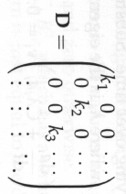
Governing equation for diffusion in a network
Let D be the diagonal matrix with vertex degrees along its diagonal.
Graph Laplacian: L=D-A
In matrix form,
A system of linear differential equations

Slide 5
Solving the system of linear differential equations
Suppose v_{i} and λ_{i} are the i^{th} eigenvector and eigenvalue.
Guess the solution has the form

Slide 6
Eigenvalues of the graph Laplacian
The Laplacian is symmetric.
It has real eigenvalues.
The Laplacian is positive-semidefinite.
All its eigenvalues are nonnegative.
The vector (1,1,…,1) is an eigenvector with eigenvalue 0.

Slide 7
Laplacian is positive semidefinite
L=D-A
L_{ij}=k_{i} if i=j
L_{ij}=-1 if i≠j and there is an edge (i,j)
L_{ij}=0 otherwise.
Arbitrary assign the two ends of an edge to end 1 and end 2.
Edge incidence (mxn) matrix B
B_{kj}=+1 if end 1 of edge k is attached to vertex j
B_{kj}=-1 if end 2 of edge k is attached to vertex j
B_{kj}=0 otherwise

Slide 8
Laplacian is positive semidefinite
It is easy to check that
Case 1: i=j (degrees of vertex i)
Case 2: i≠j and there is an edge k between i and j
In matrix form,

Slide 9
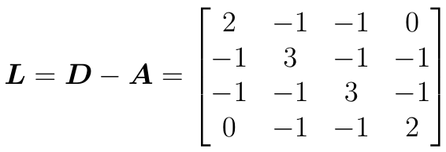
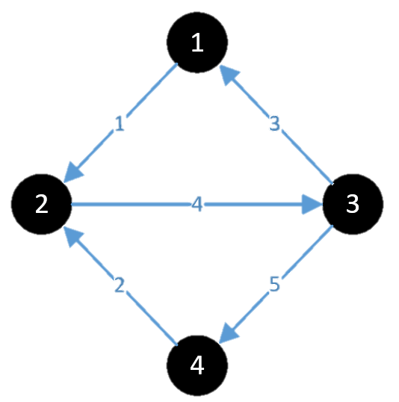
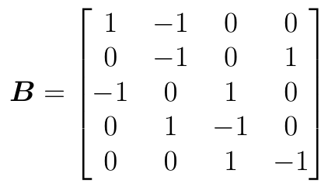
Laplacian is positive semidefinite
For example,
edge
node
1 2 3 4
1
2
3
4
5

Slide 10
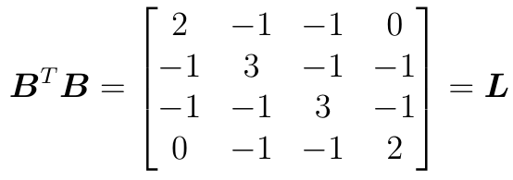
Laplacian is positive semidefinite

Slide 11
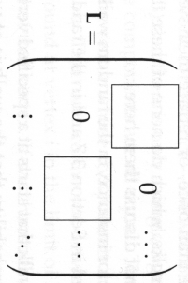
Algebraic connectivity
The number of zero eigenvalues of the Laplacian is the number of components.
The Laplacian can be written in a block form.
The network is connected if and only if the second smallest eigenvalue of the Laplacian is nonzero.
Algebraic connectivity: the second smallest eigenvalue of the Laplacian

Slide 12
Random walk
A random walk is a path across a network created by repeated random steps.
A random walk is a Markov chain.
Suppose that a walk is at vertex i at time t.
Then the next step of the walk will be at one of the neighbors of vertex i with equal probability 1/k_{i}.
Let p_{i}(t) be the probability that the walk is at vertex i at time t.

Slide 13
Random walk
In matrix form,
where D is the diagonal matrix with the degrees of vertices in its diagonal.
Reduced adjacency matrix:
where the value of the (i,j)^{th} element is and 0 otherwise.
A random walk can be reduced to repeated multiplication by a symmetric matrix (the reduced adjacency matrix)

Slide 14
The steady state of the random walk
Let
Recall that the vector 1=(1,1,…,1) is an eigenvector with eigenvalue 0.
Thus, for some constant a.
In conjunction with

Slide 15
Random walk
A random walk is a reversible Markov chain.
The transition probability matrix satisfies the detailed balance equation.
It can then be used for solving the steady state probability of the Markov chain.

Slide 16
Random walk
The first passage time: the number of steps to first reach from a vertex to another vertex.
Absorbing random walk (absorbing Markov chain): there are absorbing states. Once the walk reaches one of these states, it stops.
There are standard techniques in computing the mean first passage time for a Markov chain.

Slide 17
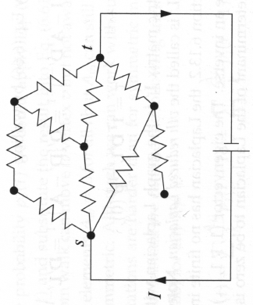
Resistor network
The edges are identical resistors of resistance R
Kirchhoff’s current law: the net current flowing in or out of any vertex is 0.
V_{i}: the voltage at vertex i
I_{i}: the current injected to vertex i by an external current source.
  I_{i} =+I if vertex i is the source node
  I_{i}=-I if vertex i is the terminal node t
  I_{i} =0 otherwise

Slide 18
Laplacian eigenmap (embedding)
Laplacian L is symmetric and positive semi-definite.
For a connected graph, all its eigenvalues are positive except the smallest one.

Slide 19
Laplacian eigenmap (embedding)

Slide 20
Resistance distance (effective resistance)

Slide 21




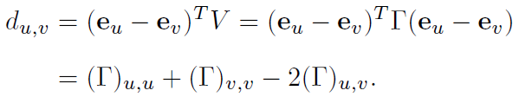
Resistance distance (effective resistance)
Consider , a unit current vector flowing from u to v.
Since ,
we can solve V in equation I = LV in terms of :
The voltage difference between u and v is

Slide 22
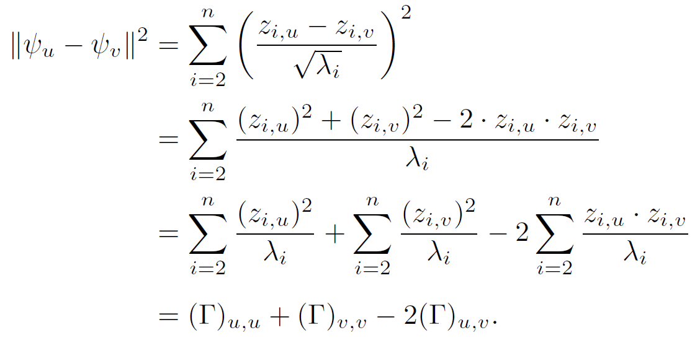
Resistance distance (effective resistance)
Moreover, by direct calculation, we have:

